Slide 1

Boeing 787 Dreamliner Rise, Downfall & Management Lessons
Presented By: Member
1 – Abdul Hadi Siddiqui
2 – Sohaib Azmat
3 – Syed Ahsan Hussain
4 – Shahrukh Ali
5 – Aamir Khan

Slide 2
Boeing Company Overview
Global aerospace leader:
Commercial, defense & space:
Large-scale systems integration:
Boeing is a major global aerospace company with expertise in designing and manufacturing commercial, defense, and space systems.
Boeing serves customers worldwide, providing cutting-edge solutions in commercial aircraft, military defense, and space exploration.
Boeing integrates complex aerospace systems, offering full-service solutions across various sectors, including commercial and defense aviation.

Slide 3
What is the 787 Dreamliner?
Long-range wide-body aircraft:
Fuel efficient:
Passenger comfort focused:
It uses composite materials and next-generation engines to achieve 20-25% better fuel efficiency than older models like the 767, cutting operational costs.
The 787 is a wide-body airliner designed for long-haul flights, offering non-stop routes between distant cities with advanced fuel efficiency.
The 787 features a quieter cabin, larger windows, improved pressurization, and better humidity control, creating a more comfortable flight experience.

Slide 4



Vision Behind 787
Point-to-point travel:
Lower airline operating cost:
Innovation leadership:
The 787 allows airlines to operate non-stop flights between more distant city pairs, reducing the need for layovers and enhancing route flexibility.
Designed to reduce fuel consumption and maintenance costs, the 787 provides airlines with a more economical long-haul solution.
The Dreamliner aimed to be a technological leader, incorporating new materials and systems to transform modern air travel.

Slide 5
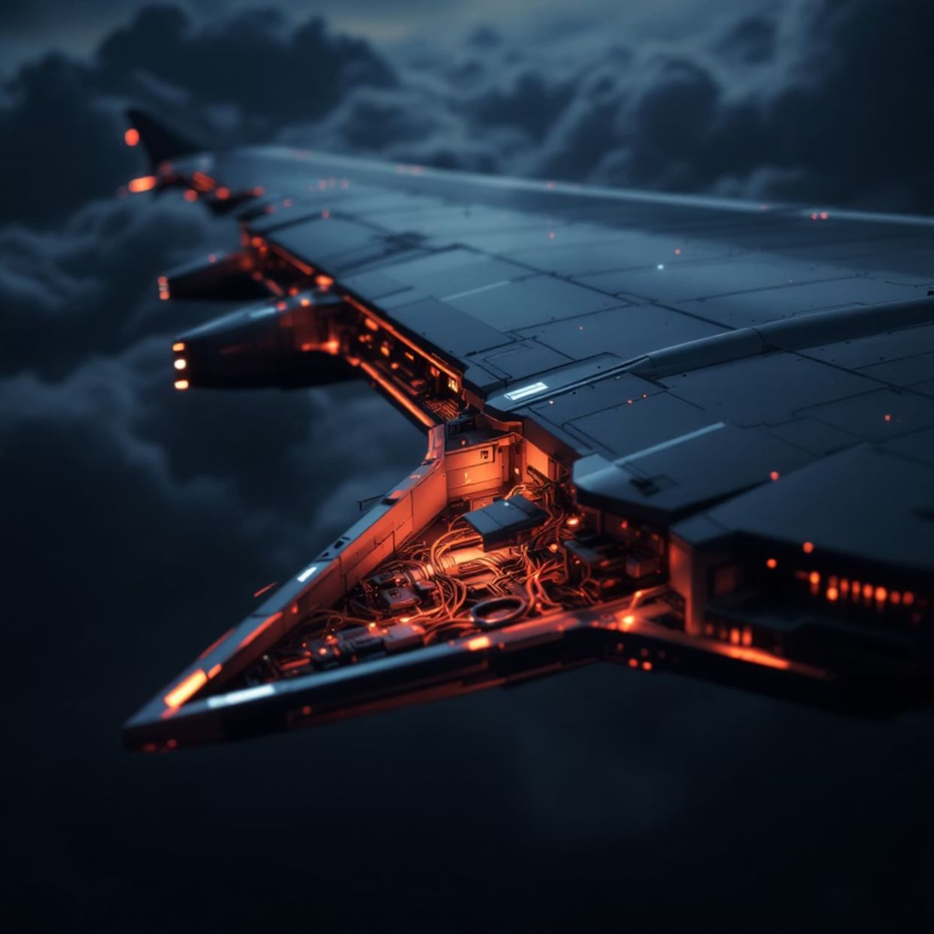
Key Innovations
Composite materials: The 787's airframe uses carbon-fiber-reinforced composites, reducing weight, increasing fuel efficiency, and offering greater durability than traditional aluminum.
Electrical systems: The aircraft replaces traditional hydraulic systems with electric ones, making the plane lighter, more efficient, and reducing maintenance costs.
Lithium-ion batteries: The Dreamliner is the first commercial aircraft to use lithium-ion batteries, which are more energy-efficient and lighter than traditional batteries.

Slide 6

Why 787 Matters
1
Strategic aircraft:
The 787 was developed as a response to market demands for more fuel-efficient, longer-range aircraft, helping Boeing stay competitive against Airbus.
2
Competitive response:
With its innovative features, the 787 directly competed with Airbus's A350, driving both companies to push the envelope in terms of technology and efficiency.
3
Megaproject transformation:
The 787's development marked a shift in how large-scale aerospace projects were managed, with a global supply chain and significant risks tied to its success.

Slide 7

Early Market Success
Fastest-selling wide-body: The 787 was the fastest-selling wide-body airliner in history, with over 1,000 orders placed by airlines before its first delivery.
Strong airline demand: Airlines were drawn to its fuel efficiency and operational cost reductions, with the 787 becoming a preferred choice for long-haul flights.

Slide 8
Technological Breakthroughs
Composite fuselage:
Improved cabin comfort:
The 787’s fuselage is primarily made from composite materials, making it lighter, more resistant to corrosion, and more fuel-efficient than traditional metal airframes.
The Dreamliner’s cabin pressure, humidity, and lighting systems are designed to enhance passenger comfort, reducing fatigue on long-haul flights.

Slide 9

Fuel Efficiency
20% less fuel use: The Dreamliner’s advanced design and materials result in a 20-25% improvement in fuel efficiency compared to older aircraft models, helping airlines cut costs.
Lower emissions: The aircraft’s fuel efficiency also translates into reduced emissions, contributing to environmental sustainability in the aviation sector.

Slide 10
Global Supply Chain
1
2
Risk-sharing partners:
Global Tier-1 suppliers:
Boeing's supply chain for the 787 is highly globalized, with many components produced by risk-sharing partners, reducing Boeing's financial burden but increasing complexity.
Major suppliers, including companies from Japan, Italy, and the U.S., play a crucial role in producing the various parts and systems that make up the Dreamliner.

Slide 12

Competitive Advantage
Long range
The 787’s long-range capability (up to 8,000 nautical miles) enables airlines to serve more destinations directly, reducing layovers and improving efficiency.
Mid-size capacity
With a capacity to carry 242–330 passengers, the 787 fills a market gap between smaller single-aisle jets and larger wide-body aircraft, offering flexibility in passenger capacity.

Slide 13

Early Brand Impact
Strong innovation image
The 787 was marketed as a technological marvel, boasting innovations like composite materials and electric systems, positioning Boeing as a leader in aviation.
Large backlog
The Dreamliner’s early success was also evident in its large order backlog, with over 1,000 units sold before its first delivery, reflecting high airline demand and confidence.

Slide 14



Program Delays
Repeated postponements
The 787 experienced several delays, with its first delivery pushed back multiple times due to design and manufacturing challenges.
Schedule overruns
The delays significantly impacted Boeing’s ability to meet the original delivery schedule, creating dissatisfaction among customers and stakeholders.

Slide 15

Supply Chain Failures
1
Poor coordination
Boeing’s global supply chain faced coordination challenges, with multiple suppliers struggling to meet deadlines or provide the necessary parts, delaying the overall program.
2
Incomplete parts
Some parts were delivered incomplete or of substandard quality, leading to rework and affecting the overall assembly schedule.

Slide 16
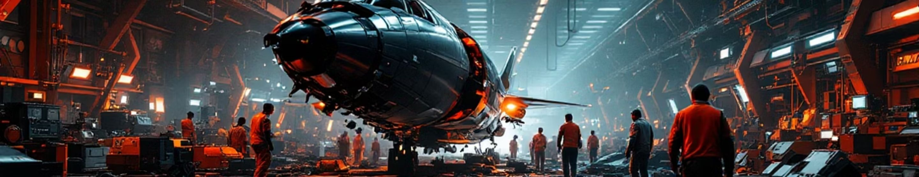
Manufacturing Issues
Fastener shortages
Rework
The manufacturing process was slowed by shortages of critical fasteners, which were essential for assembly, leading to production delays.
Due to quality control issues and faulty parts, significant rework was required at various stages of the manufacturing process, adding to the delays and costs.

Slide 17



Battery Crisis
Fire incidents
Global grounding
In 2013, the 787 was grounded worldwide after two incidents involving lithium-ion battery fires, highlighting a major safety risk in the aircraft's design.
The grounding of the fleet for several months cost Boeing and its customers millions of dollars in lost revenue and damage to its reputation.

Slide 18

Labor Strikes
1
2
Workforce unrest
Productivity loss
Strikes by Boeing’s labor unions, particularly over issues like job security and production timelines, further exacerbated delays and manufacturing difficulties.
The strikes led to significant productivity loss, with halted production lines and delays in meeting assembly deadlines, further compounding supply chain issues.

Slide 19



Reputation Damage
Financial penalties
The delays and failures led to several financial penalties imposed by customers, including airlines and suppliers, resulting in a significant financial impact for Boeing.
Customer dissatisfaction
Airlines that had long awaited the Dreamliner were frustrated by delays and quality issues, leading to a tarnished reputation in the industry.

Slide 20
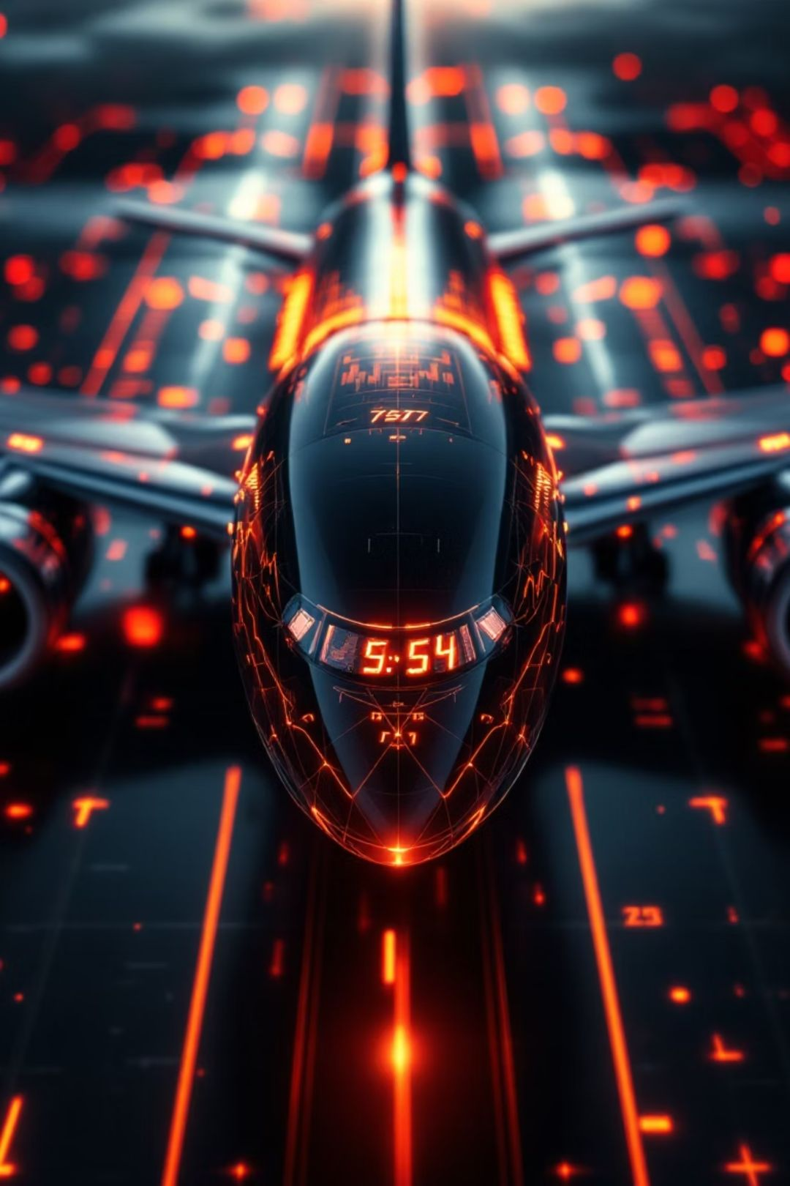
Cost Overruns
Unrealistic budgets: The development of the 787 exceeded initial cost estimates, with an early budget of $6 billion ballooning to over $20 billion due to delays, design issues, and unforeseen challenges.
$20B+ overruns: Boeing faced over $20 billion in cost overruns, which were the result of repeated delays, design changes, and challenges with the global supply chain. The financial pressure mounted, impacting both short-term and long-term profitability.

Slide 21
Cost Breakdown Table:
Category
Initial Estimate
Final Estimate
Overrun
Development Costs
$6B
$20B+
$14B+
Supply Chain Issues
Included in budget
Increased costs due to supplier delays
$4B+
Manufacturing Delays
Included in budget
Impacted production and rework
$2B+
Battery Safety Crisis
Not initially budgeted
Grounding and redesign costs
$1.5B+
Program Delays (General)
Included in budget
Schedule overrun led to cost of rescheduling and operational losses
$3B+
Note: The overrun table reflects estimates based on available data and includes both visible and hidden costs arising from various stages of the project.

Slide 22

Slide 20 – Financial Issues
Deferred costs: Boeing deferred a significant portion of the 787’s costs, accounting for billions in expenditures to be paid over time, thus creating a financial imbalance in the company’s immediate cash flow.
Cash flow stress: Due to the delays, cost overruns, and ongoing issues, Boeing experienced severe cash flow stress, making it difficult to fund ongoing operations and future development, requiring strategic financial adjustments.

Slide 23
Financial Impact Table:
Financial Aspect
Estimated Value
Impact
Cost Overruns
$20B+
Major financial pressure, reduced profitability
Deferred Costs
$10B
Deferred costs caused immediate cash flow challenges
Loss of Revenue (Grounding)
$3B+
Financial loss from grounded fleet, delayed deliveries
Penalties to Airlines
$1.5B+
Compensation and financial penalties to customers for delays
Operational Costs
$2B+
Increased due to ongoing production issues and rework
Note: The figures represent the combined impact of both direct and indirect financial strains caused by delays, safety concerns, and operational disruptions.

Slide 24
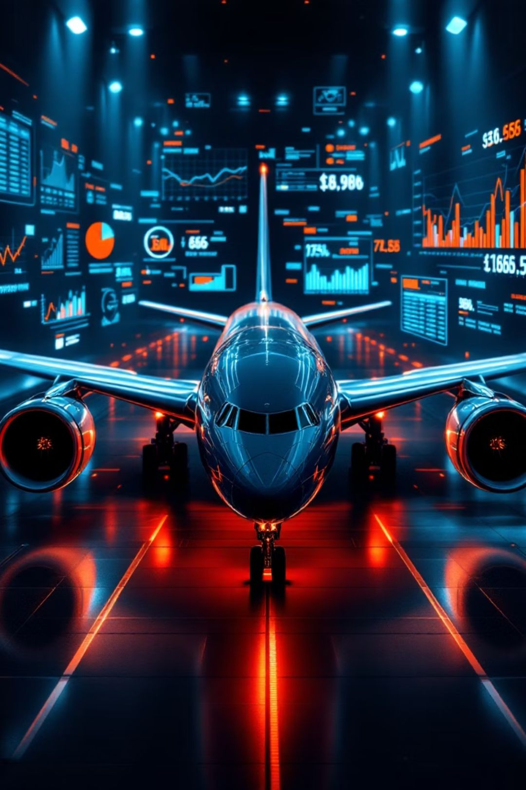
These tables provide a clear breakdown of the costs and financial challenges Boeing faced due to the $20B+ cost overruns and financial difficulties during the 787 program. Let me know if you'd like to expand further or add anything else!

Slide 25

Outsourcing Failure
Boeing outsourced over 70% of 787 production to reduce costs, but suppliers failed to meet timelines and quality standards.
Weak oversight of the global supply chain led to poor coordination, incomplete parts, and manufacturing delays.
Boeing had to depend on more than 50 suppliers, which caused inconsistent quality and communication breakdowns.
Supplier delays and poor part quality resulted in $2 billion in penalties and lost revenue.

Slide 26
Slide 22 – PM Methodology Issues
Rigid Waterfall Approach
Integration Failures
The waterfall project management approach was too rigid to handle the evolving challenges of the 787 program.
Integration between over 50 suppliers and 20 systems failed, resulting in part failures, rework, and production delays.
Hindered Iterative Testing
Lack of Agility
The waterfall model hindered iterative testing and feedback, which slowed problem resolution during critical phases.
Lack of agility in addressing unexpected challenges caused production bottlenecks, leading to massive delays.

Slide 27

Slide 23 – Risk Management Weakness
Many critical issues, like the lithium-ion battery fires, were only detected late, preventing proactive fixes.
Without effective monitoring tools, Boeing struggled to track ongoing risks, allowing problems to worsen over time.
Delays in identifying critical issues led to grounded planes and additional financial penalties.
The failure to monitor supplier performance meant that quality issues went unnoticed until they caused significant disruptions.

Slide 28
Slide 24 – PM Lessons
Complexity Underestimated
Governance Gaps
Boeing underestimated the complexity of managing global supply chains and integrating new technologies, leading to unforeseen challenges.
Weak governance structures led to unclear accountability, especially in managing supplier performance, causing delays and cost overruns.
Leadership Gaps
Planning Failures
The lack of centralized decision-making and clear authority in the project led to missed opportunities for early intervention.
Boeing did not fully account for the challenges of innovation and integration, which added unexpected risks and delays.

Slide 29

Slide 25 – Corrective Actions
Supplier Acquisition
Improved Auditing
Boeing acquired key suppliers involved in critical components to regain control and improve oversight over production.
Boeing implemented stricter supplier audits, ensuring higher compliance with quality standards and improving production timelines.
In-House Control
Streamlined Processes
The company increased in-house production capabilities, bringing some critical manufacturing processes under direct control to improve quality.
More streamlined internal processes helped Boeing reduce reliance on external partners, allowing for better integration and faster production.

Slide 30




Slide 26 – Improved PM
Strong Controls
Hybrid Approach
Boeing implemented stronger project management controls, improving visibility, accountability, and tracking of production progress.
A hybrid of agile and waterfall project management methodologies was adopted, enabling more flexibility in addressing changes and challenges.
Better Communication
Faster Decision-Making
With stronger internal controls, Boeing improved communication across teams and suppliers, allowing quicker identification of issues.
The hybrid approach sped up decision-making by allowing agile adjustments within a larger structured framework.

Slide 31
Slide 27 – Financial Recovery
14
157
15%
Aircraft/Month
787s Delivered
Revenue Growth
Boeing ramped up 787 production rates, reaching 14 aircraft per month by 2016, which helped generate significant revenue.
By 2020, Boeing had delivered 157 787s, significantly improving cash flow and increasing market share.
The 787’s strong market demand contributed to a 15% year-over-year growth in Boeing’s commercial aircraft sales.
The 787 became Boeing's most profitable aircraft, with long-term orders and growing market demand driving sustained financial recovery.

Slide 32

Slide 28 – Quality Improvements
Supplier audits: Regular audits were introduced to ensure suppliers met stringent quality standards, helping detect issues early and prevent defects.
Better documentation: Boeing introduced more rigorous documentation processes, ensuring all parts and components were tracked and quality was maintained throughout production.
Tighter standards: Stricter quality checks were implemented at every stage of production, reducing the risk of defective components reaching assembly.
Increased inspections: Boeing now performs more detailed inspections and quality assurance tests on parts before they are integrated into the assembly line.

Slide 33
Slide 29 – Strategic Lessons
1
2
Balance Outsourcing
Manage Risks
The 787 program emphasized the importance of balancing outsourcing with in-house manufacturing to retain control over key parts of production.
Stronger risk management frameworks are necessary to detect and address issues earlier, with clear contingency plans for mitigating supply chain and quality risks.
3
4
Supplier Management
Early Planning
Effective supplier management is critical to ensuring timely deliveries and quality parts in large-scale projects like the 787.
Early identification and assessment of potential risks would have prevented many of the delays and cost overruns Boeing faced.

Slide 34

Slide 30 – Conclusion
Success & warning case: The 787’s success in revolutionizing the aviation industry also serves as a warning for managing large, complex megaprojects with multiple stakeholders.
PM learning landmark: Boeing’s 787 project is a landmark example of project management failure and recovery, providing valuable lessons for future high-risk, high-reward projects.
Innovation vs execution: The 787 demonstrated the importance of balancing technological innovation with execution discipline and risk management.
Megaproject management: The program showed that effective governance, risk management, and supplier coordination are essential for the success of megaprojects.

